Slide 1
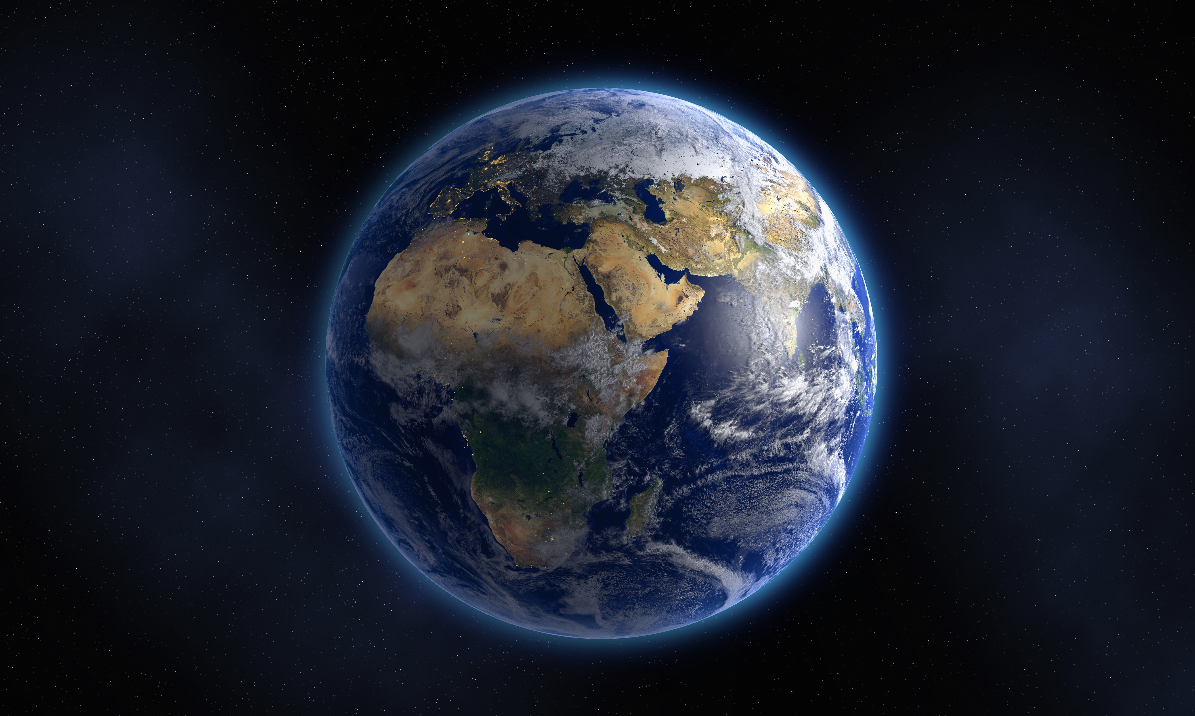
Visualize a Space Mission Using Virtual Reality
SpaceHackers
Artemis II VR mission

Slide 2
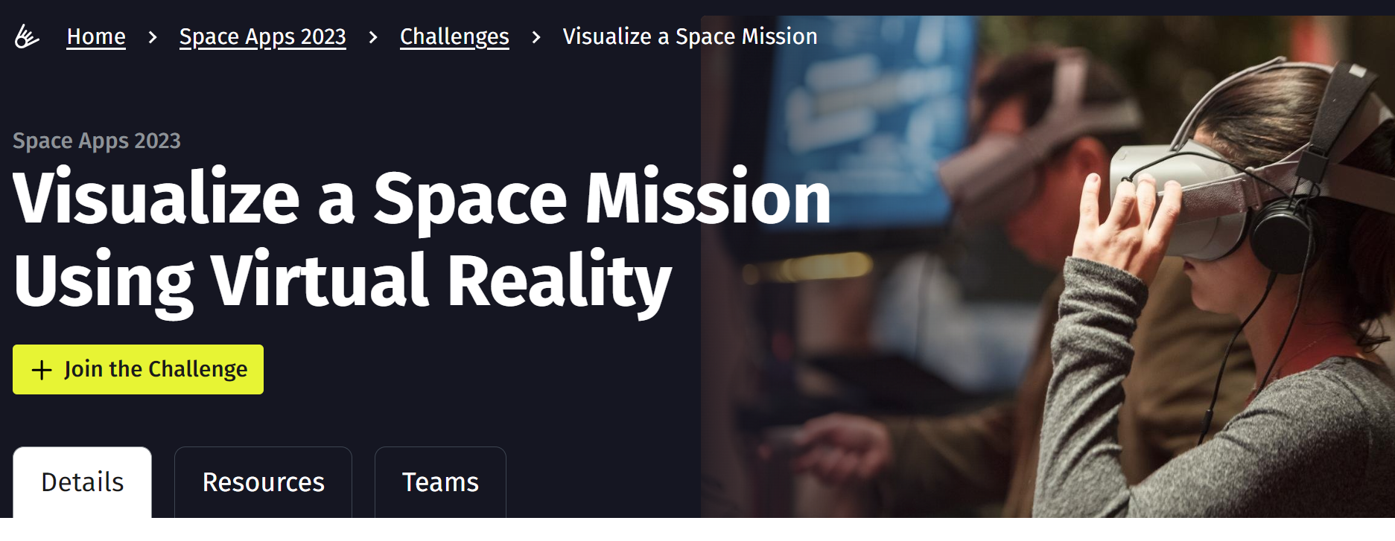
Our challenge
Imagine an Earth-orbiting satellite, or an Earth-to-Moon mission that requires an orbital transfer maneuver, or a spacecraft in a cyclical orbit around Earth and Mars, or a deep space probe that traverses the asteroid belt. Understanding and visualizing sophisticated space missions isn’t easy! Your challenge is to create an interactive, virtual reality application that enables users to visualize a space mission including the mission concept, orbital trajectories, and mission timeline.

Slide 3
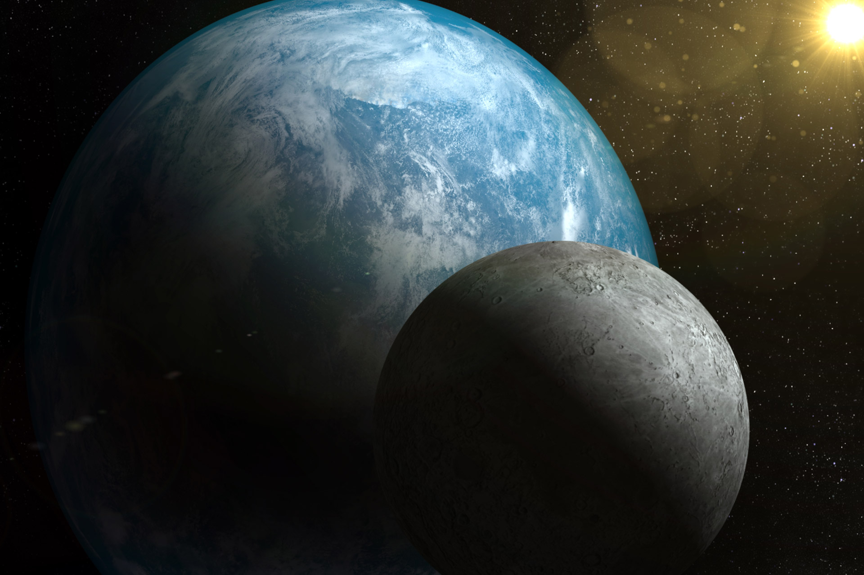

Artemis 2 (officially Artemis II) is the second scheduled mission of NASA’s Artemis program and the first scheduled crewed mission of NASA’s Orion spacecraft currently planned to be launched by the Space Launch System (SLS) in November 2024.^{[1]} Four astronauts are to perform a flyby of the Moon and return to Earth, being the first crewed mission beyond low Earth orbit since Apollo 17 in 1972. The mission is also planned to be the first crewed launch from Launch Complex 39B of the Kennedy Space System since STS-116 in 2006.

Slide 4
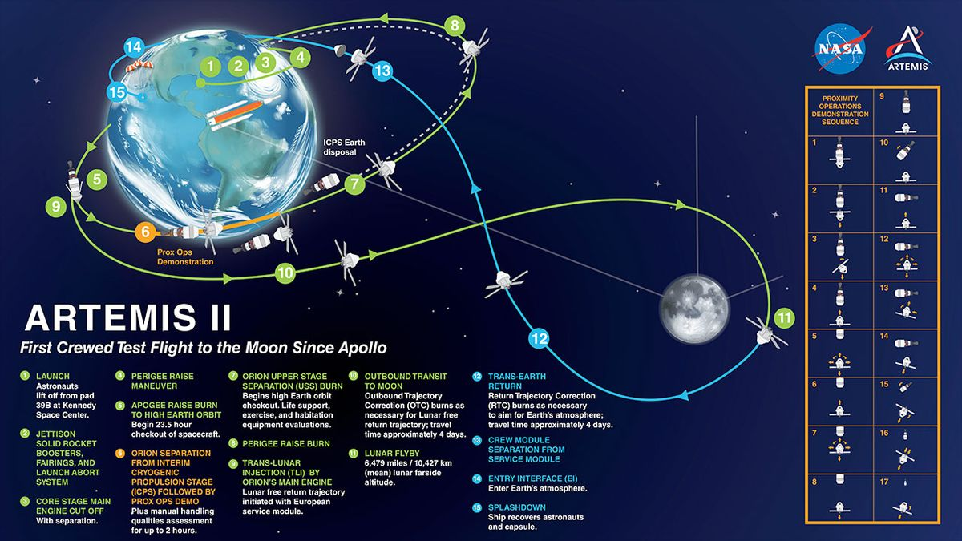

Slide 5
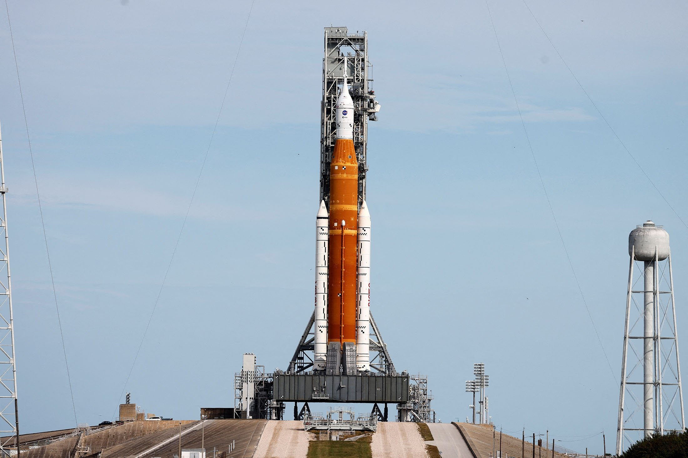
The three-stage Saturn V had 5 F-1 engines on its first stage, producing 7.5 million pounds of thrust to lift off. Once in orbit, five engines on the second stage provided the power to send the Apollo on its path to the moon.
One of the things the two rockets have in common is the propulsion systems are both developed by Aerojet Rocketdyne and the company's predecessors. The company provides 39 propulsion elements for the SLS and Orion from the booster, upper stage, the jettison motor for the launch abort system and Orion's main engine.

Slide 6
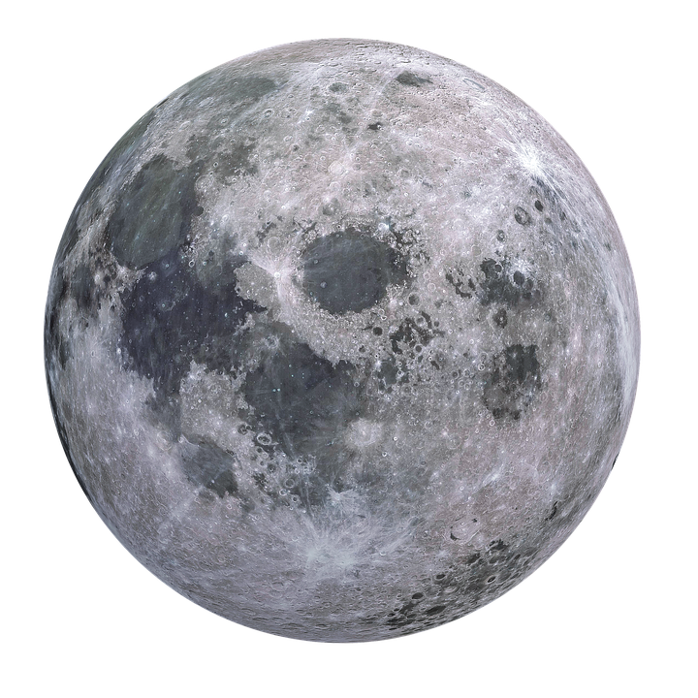

We will show you a 3D iteration of the Artemis II point of view.

